Slide 1
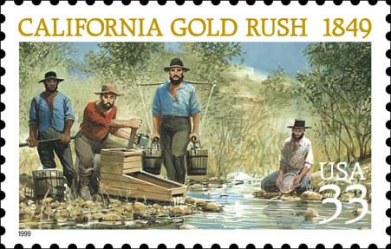

Slide 2
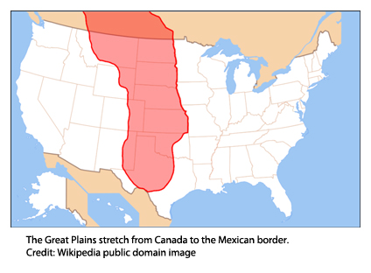
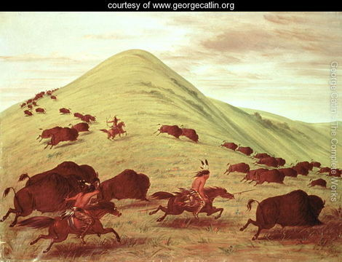
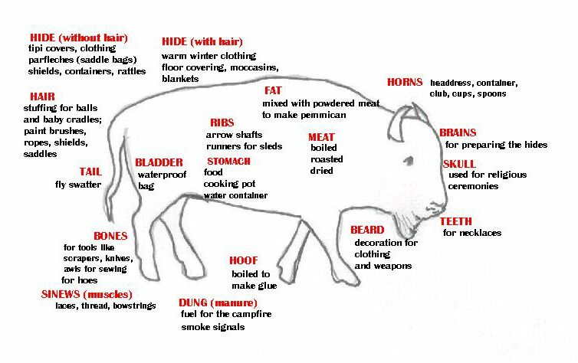
The Great Plains

Slide 3
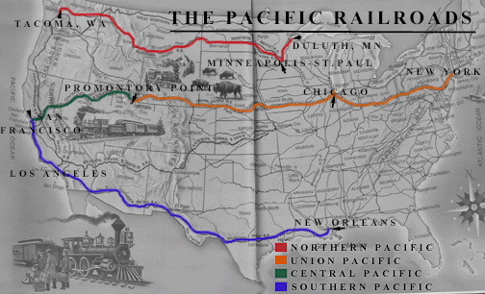
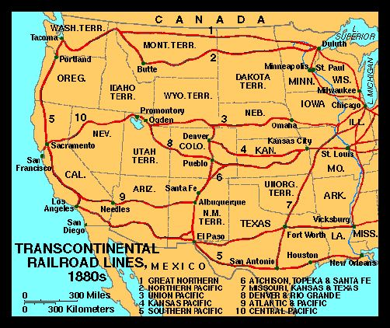

Slide 4
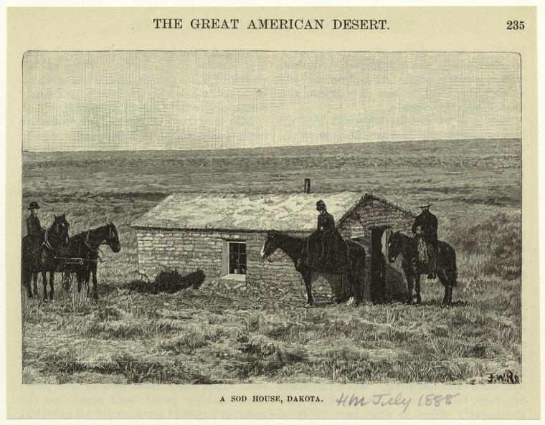
1862 – Homestead Act

Slide 5
The plight of the Amerindians
1868 – Fort Laramie treaty
1876 – Battle of the Little Big Horn
1890 – Wounded Knee Creek
1924 – Indian Citizenship Act
1934 – Indian Reorganization Act

Slide 6
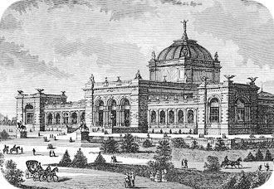
1876 Centennial Exposition

