Slide 1
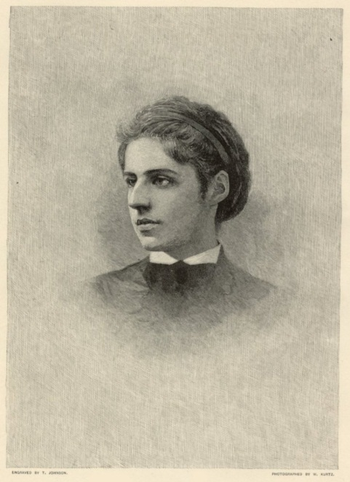
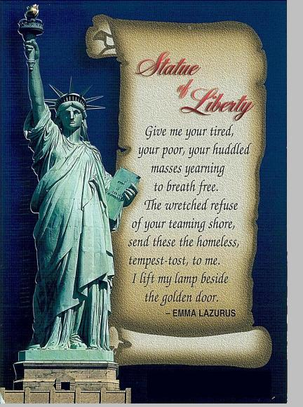
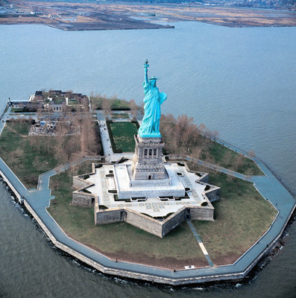
Emma Lazarus

Slide 2
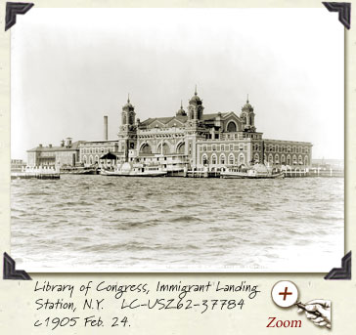
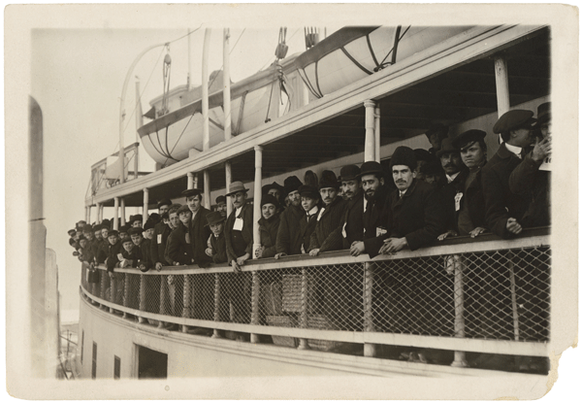
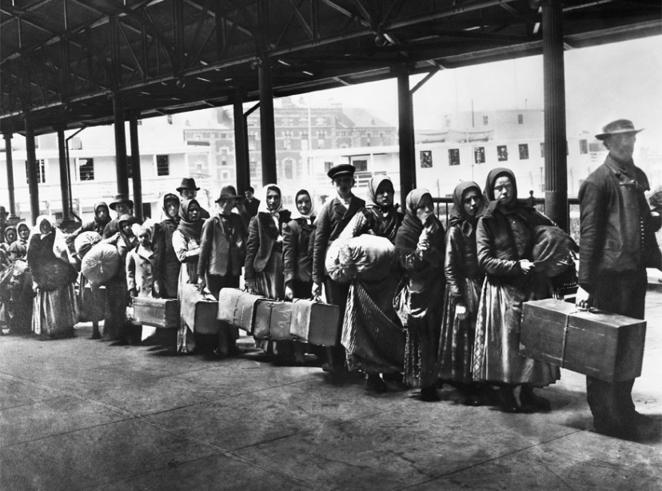
Ellis Island (1892 – 1954)

Slide 3
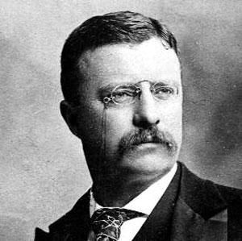
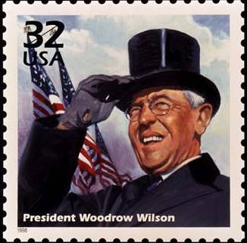
1901 - Theodore Roosevelt
A Square Deal
1909 – Woodrow Wilson
The New Freedom

Slide 4
An American Empire
1867 – Alaska purchase
1898 – Spanish-American War
1823 – the Monroe Doctrine
1901 – Roosevelt’s Corollary
1959 – Hawaii became the 50th state
Panama Canal

Slide 5
The Great War
The Allies (France, GB, Russia)
The Central Powers (Germany, Austria)
May 1915 – the sinking of the Lusitania
President Wilson – the League of Nations
2 April 1917 – entry into war

