Slide 1
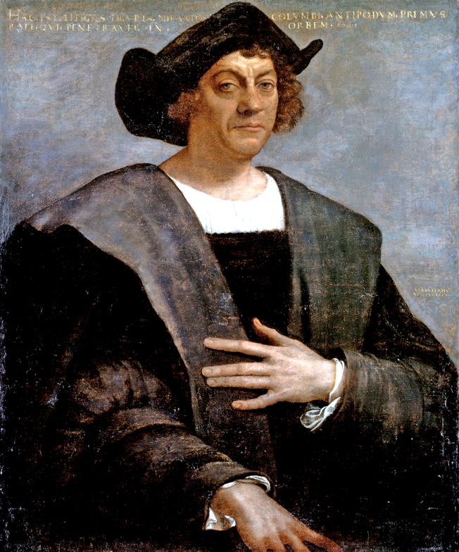
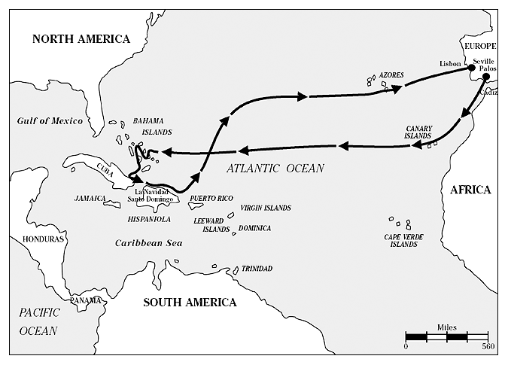
Christopher Columbus (1451-1506)
3 August 1492
3 ships: the Nina,
the Pinta, the Santa Maria

Slide 2
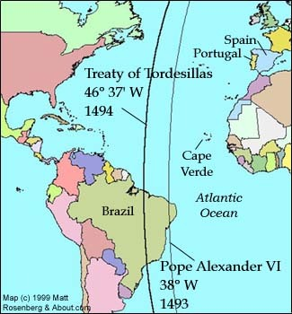
Line of Demarcation ( 1493) Treaty of Tordesillas (1494)

Slide 3
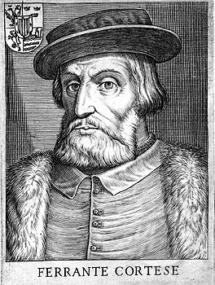
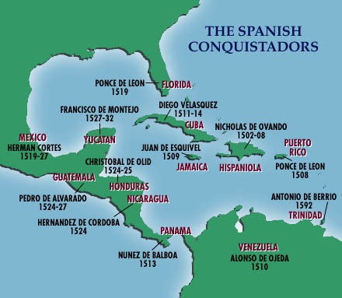
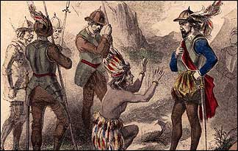
Conquistadors
1520s – Hernando Cortes
1530s – Francisco Pizzarro
Why? - ‘divide and rule’ principle
- lust for gold

Slide 4
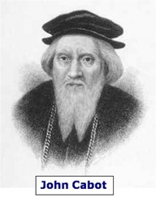
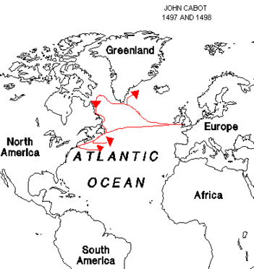
John Cabot - 1497

Slide 5
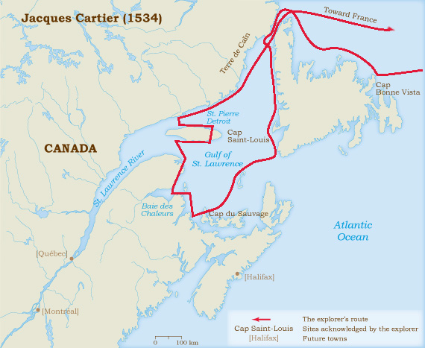
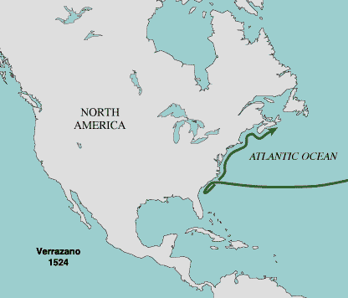
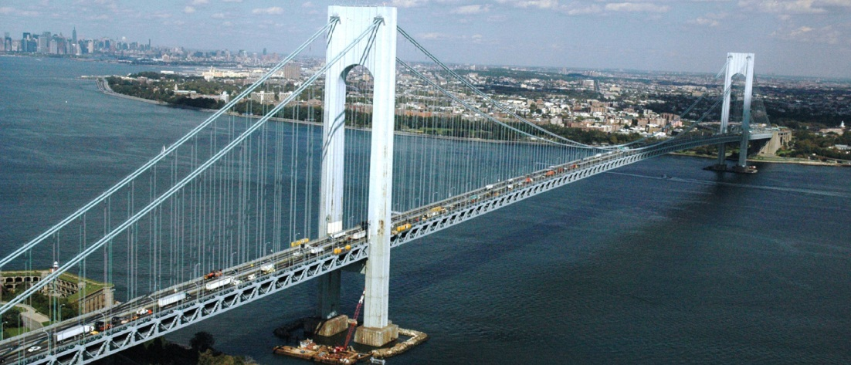
Jacques Cartier – 1534
Giovanni da Verrazano
1524

Slide 6
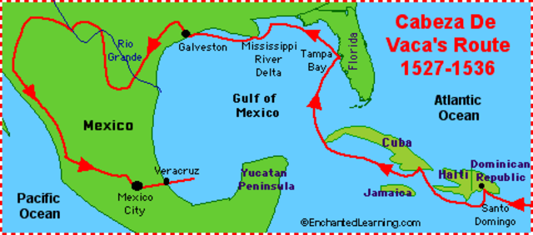
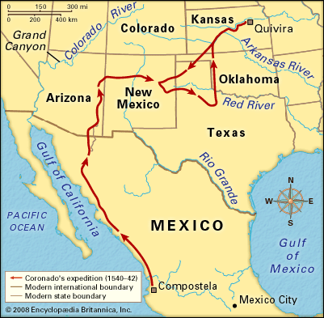
Spanish explorers of North America
1528 – Cabeza de Vaca
1539 –
Vacquez Coronado

Slide 7
Sir Francis Drake - 1577

