Slide 1
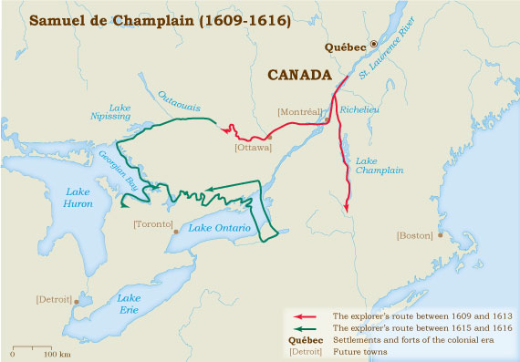
New France
1608 – Samuel de Champlain – Quebec

Slide 2
New Netherland

Slide 3
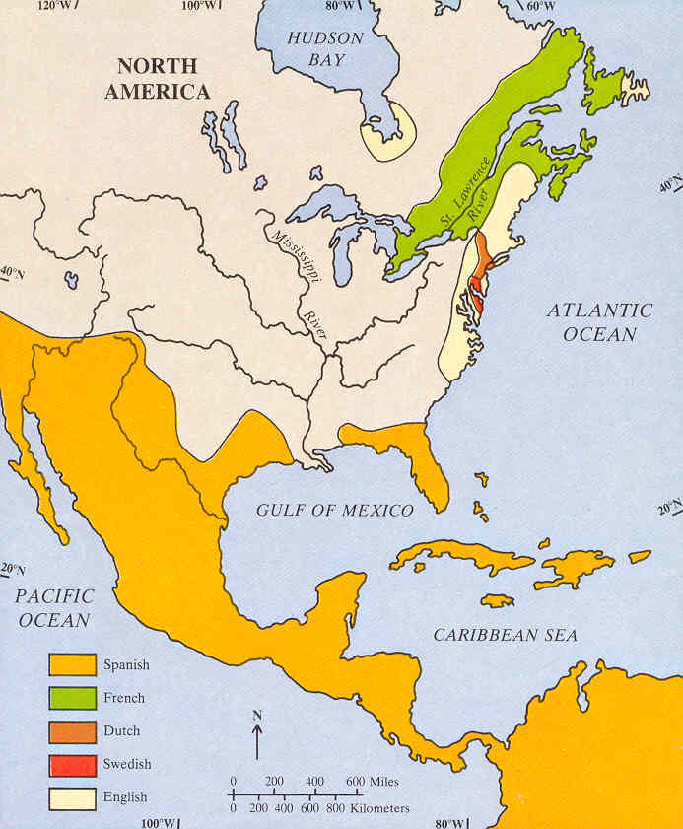
European colonial settlements 1661

Slide 4
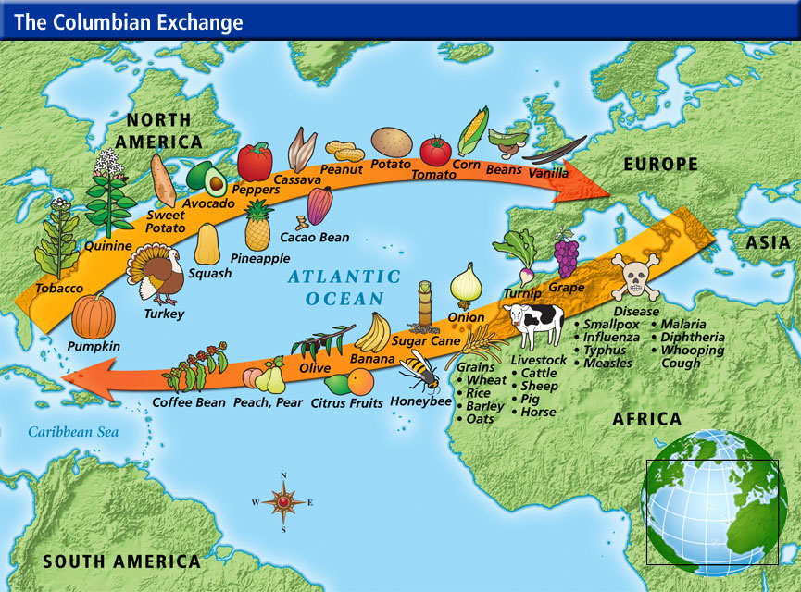

Slide 5
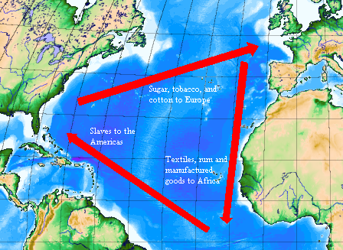
Slavery – The triangular trade

Slide 6
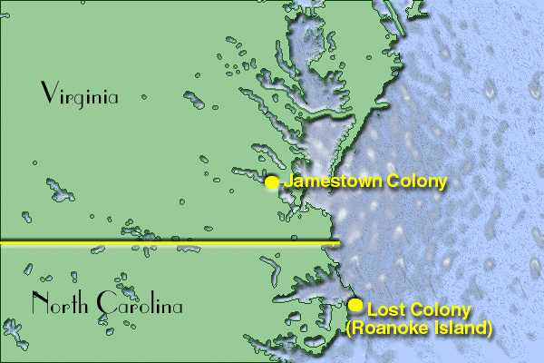
The English colonies
1585 – Sir Walter Raleigh – Roanoke Island
1607 – Jamestown

Slide 7
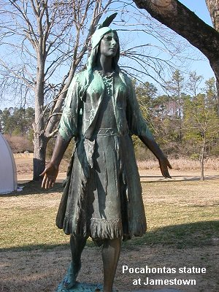
Pocahontas

Slide 8
House of Burgesses

Slide 9
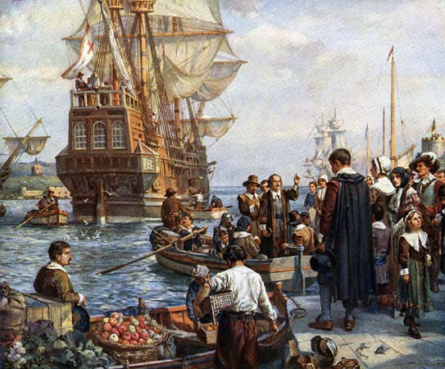
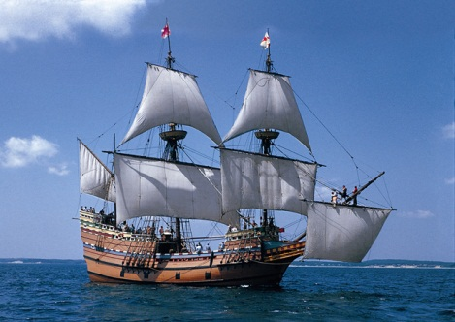
1620 – Mayflower, Pilgrim Fathers

Slide 10
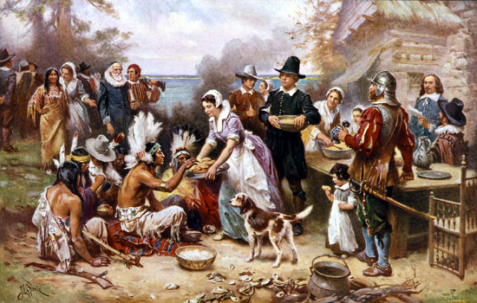
Mayflower Compact - Thanksgiving

Slide 11
1630 Massachusetts Bay Colony

