Slide 1
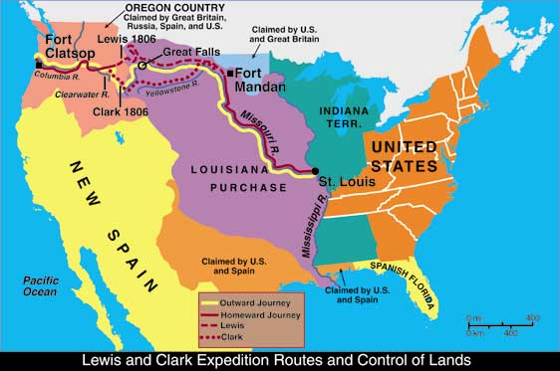
Lewis and Clark 1804-1806

Slide 2
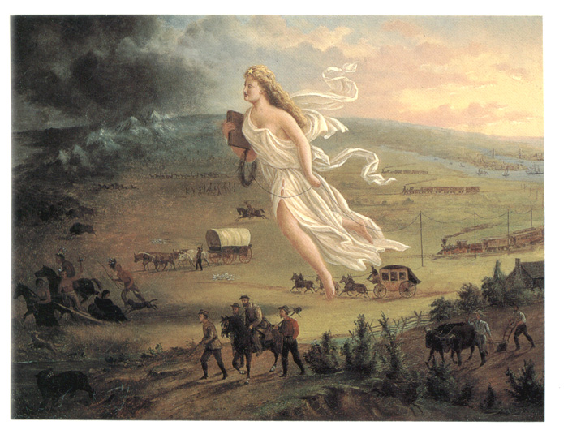
Manifest Destiny
John Gast: American Progress (1872)

Slide 3
