Slide 1
The growth of slavery in North America
1619 – the first slaves arrived
By 1775 - 500,000 slaves in the south
1808 – abolition of slave trade
1860 – 4 million slaves

Slide 2
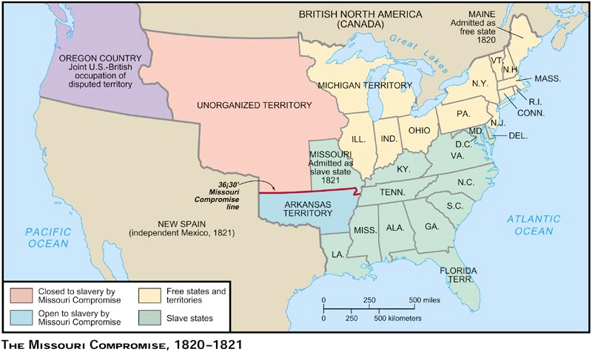
The Missouri Compromise of 1820

Slide 3
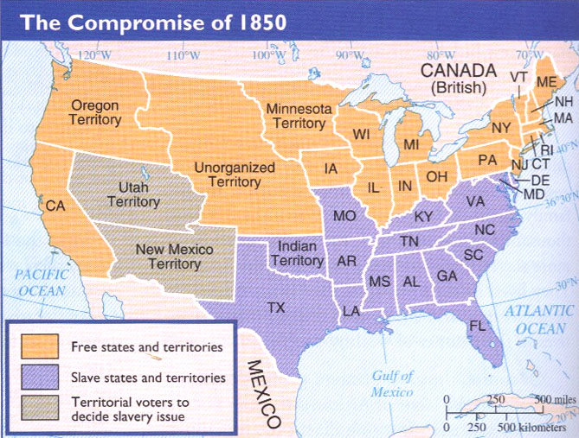

Slide 4
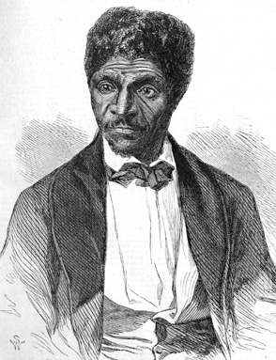
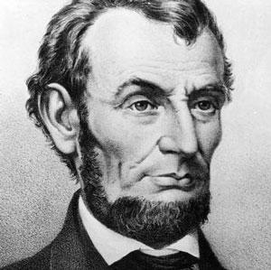
1850 – Fugitive Slave Act
Bounty hunters
1858 – Dred Scott
1854 - The Republican Party
Abraham Lincoln
- US President 1861-5
Dred Scott

