Slide 1
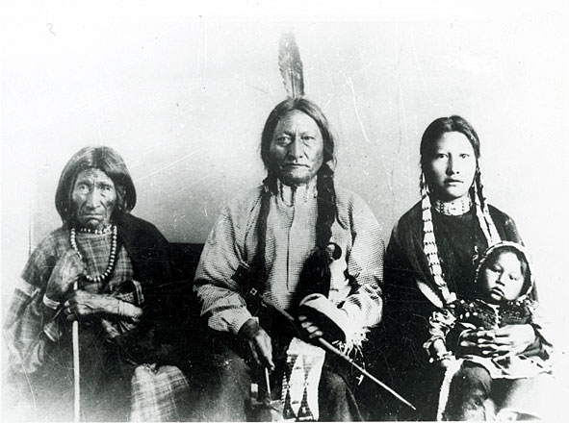
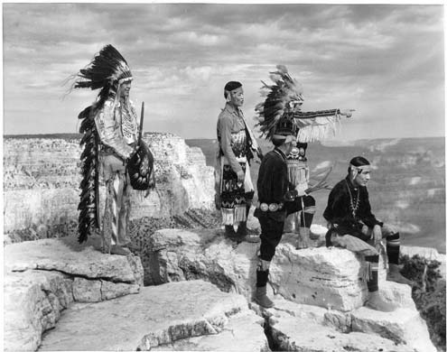
The first Americans
Who were they?
Where did they come from?
How did they live?

Slide 2
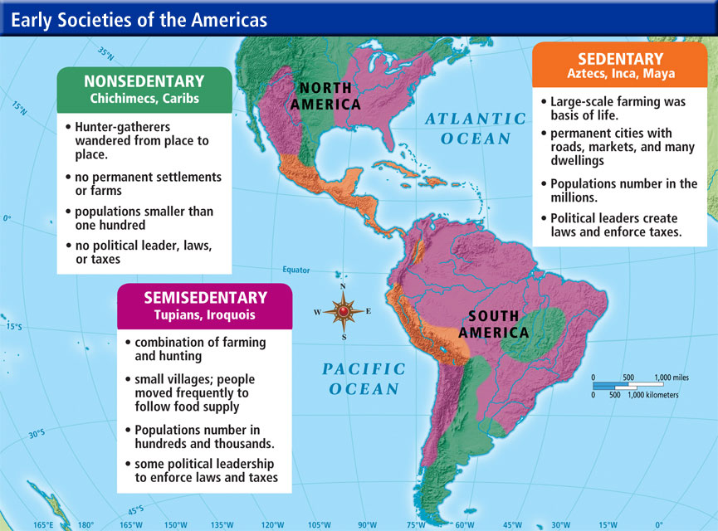

Slide 4
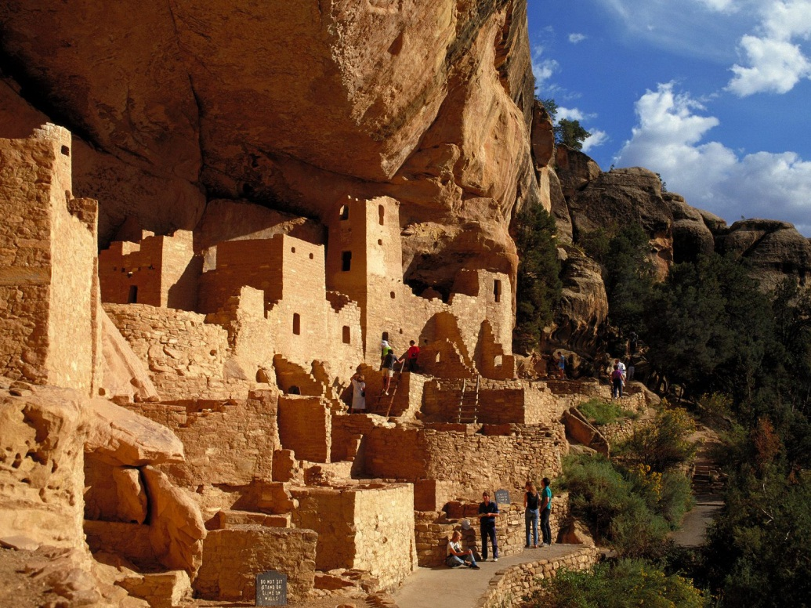
Pre-contact societies
1200 BC – 400 BC - the OLMEC people
AD 250 to 900 – the Maya culture
1300-1500 – the Incas
The Aztec people
• The Iroquois people
The Pueblo people
Mesa Verde

Slide 5
Europe in the 14th-15th c.
The Great Famine 1315-1317
The Black Death 1348-1350
The Renaissance
The Reformation
The printing press – Gutenberg – 1440s

Slide 6
The Americas
Sedentary / nonsedentary / semisedentary
Mix of farming and hunting
Spiritual belief linked to nature
Europe
Mostly sedentary
Farming
Christianity

Slide 7
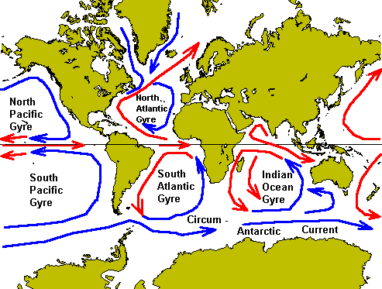
The Age of Discovery
Currents

Slide 8
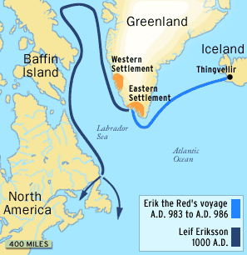
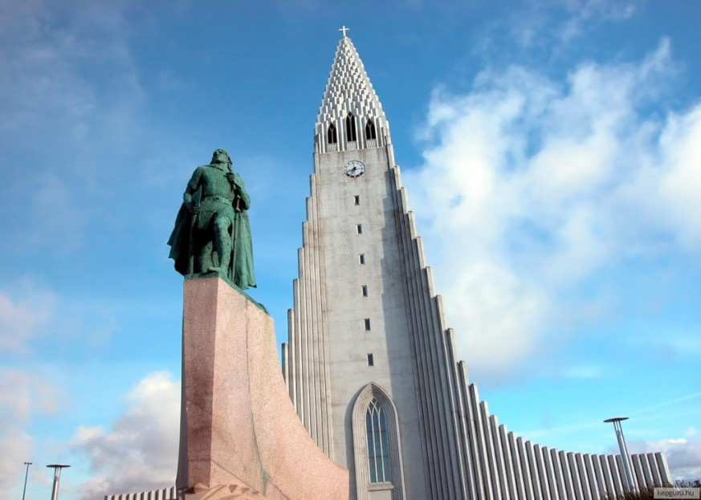
Who discovered America?
AD 459 – a Buddhist monk: Hoei-Shin
AD 551 – an Irish monk: Brendan the Bold
AD 1000 – A Viking sailor:
Leif Ericson, „Lucky Leif”
Reykjavik, Iceland

Slide 9
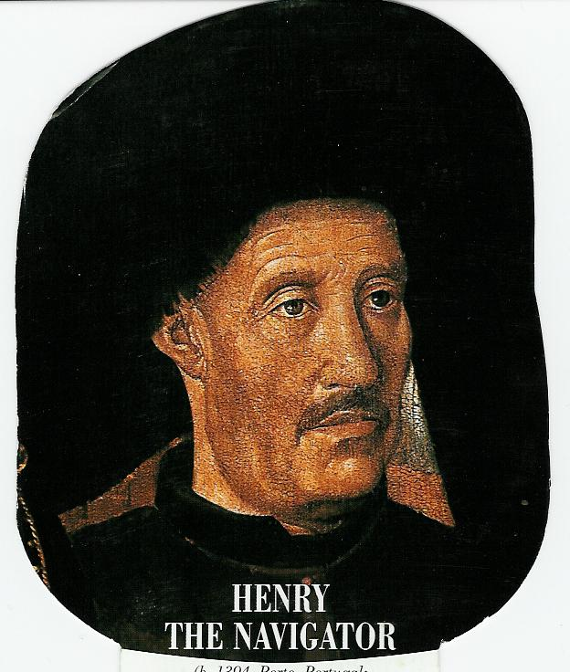
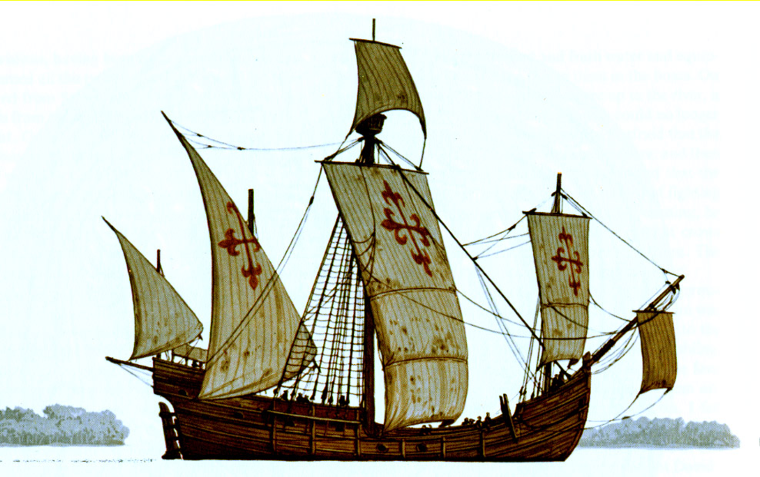
The Portuguese
Henry the Navigator
1488 – Bartolomeu Dias
1498 – Vasco de Gama
caravel

