Slide 1
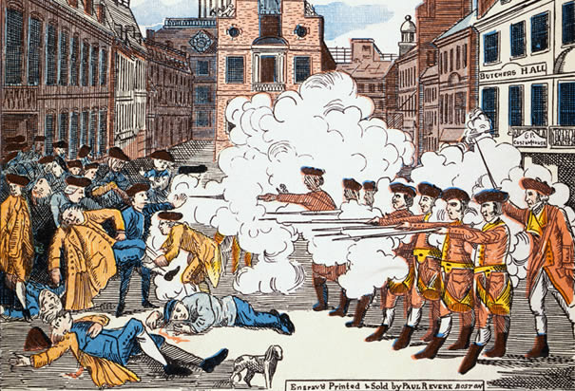
1765 – Stamp Act
1766 – Declaratory Act
1770 - Boston Massacre
A print by Paul Revere

Slide 2
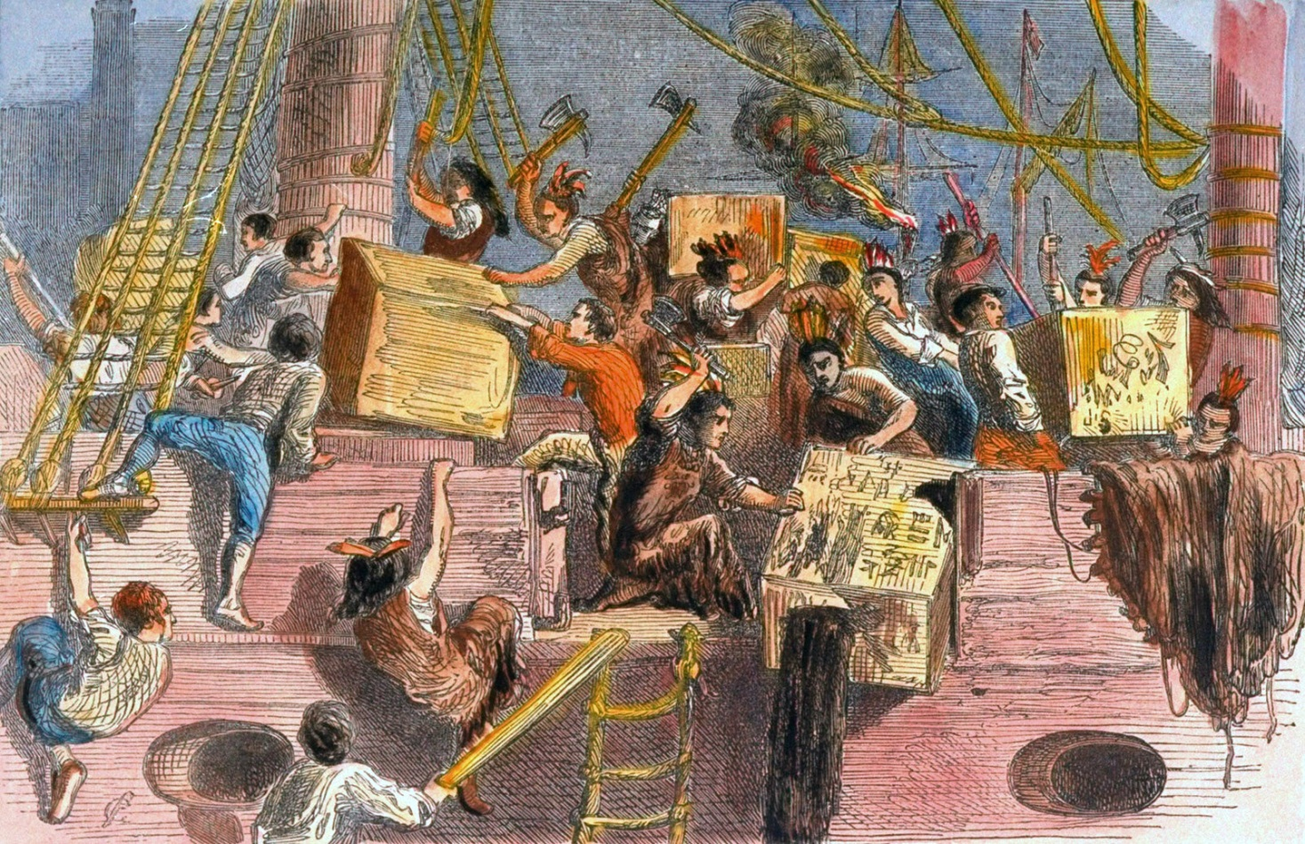
1767 – new taxes on tea, paper, etc.
1770 – all duties were removed except for the one on tea
1773 – Boston Tea Party

Slide 3
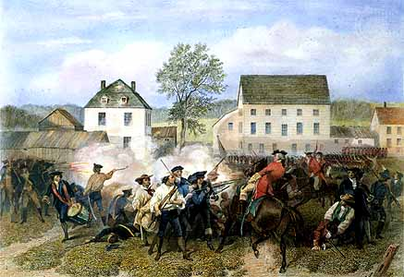
The Intolerable Acts
1774 – First Continental Congress
18 April 1775 – Lexington, Concord, Minutemen

Slide 4
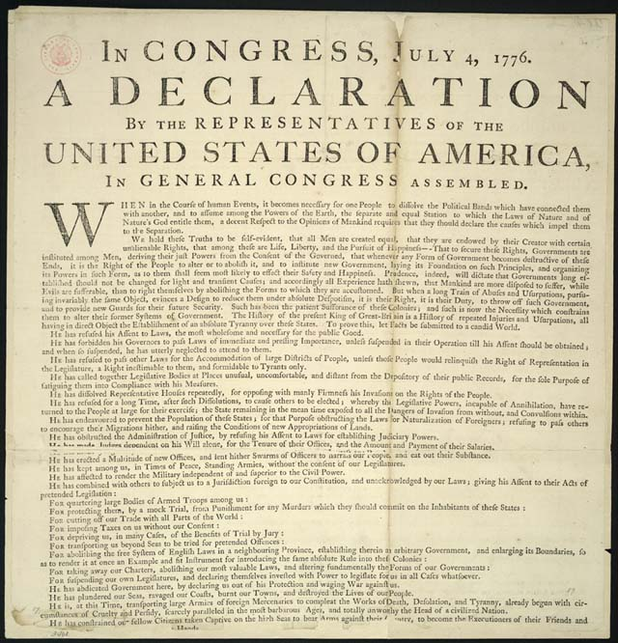
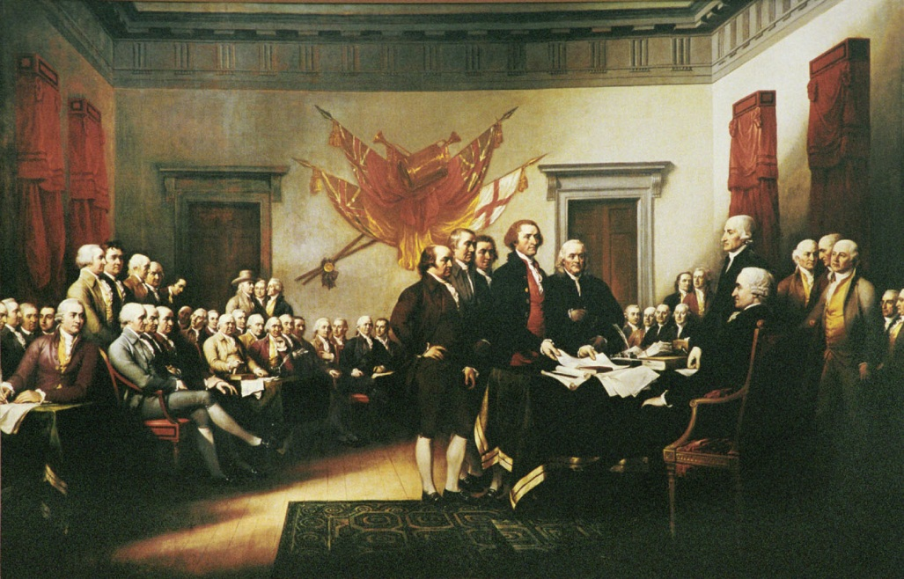
May 1775 – Second Continental Congress
4 July 1776 – Declaration of Independence
- Thomas Jefferson, John Locke

Slide 5
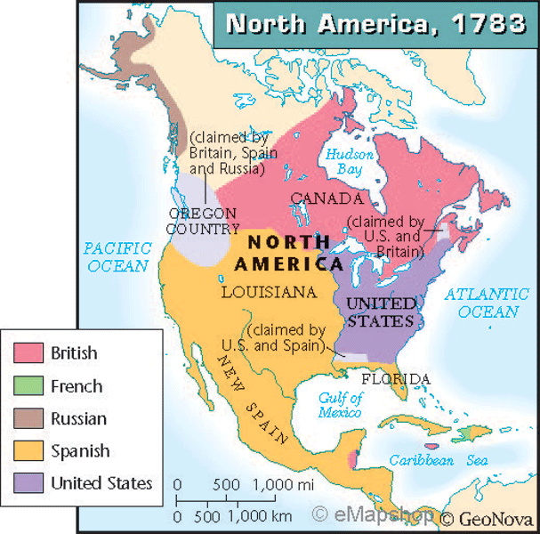
American War of Independence 1776 - 1783
October 1777 – Saratoga
Februar 1778 – alliance with France
17 October 1781 – Yorktown, Virginia
September 1783 – Treaty of Paris

Slide 6
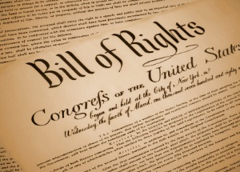
1781 – Articles of Confederation
May 1787 – Constitutional Convention
Federal system of government
1791 – Bill of Rights

