Slide 1
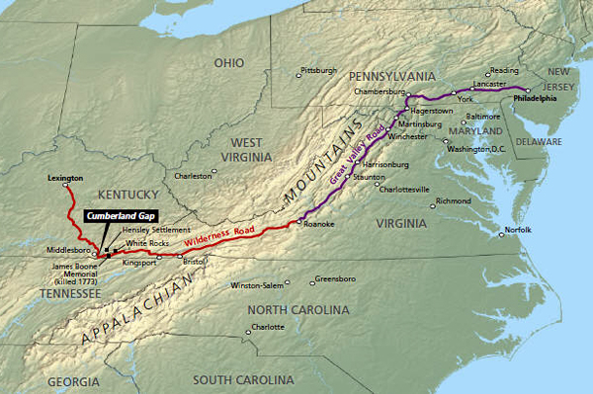
1775 - Daniel Boone

Slide 2
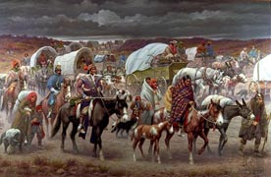
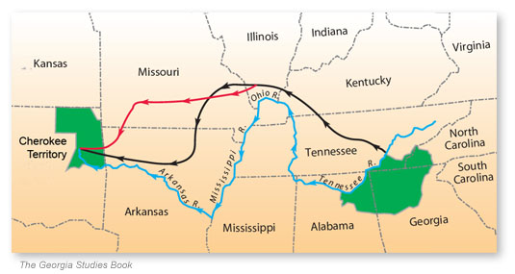
Westward Expansion
1787 – Northwest Ordinance law
1817 – President Monroe
1830 – Indian Removal Act
1838 – Trail of Tears
Cherokees

Slide 3
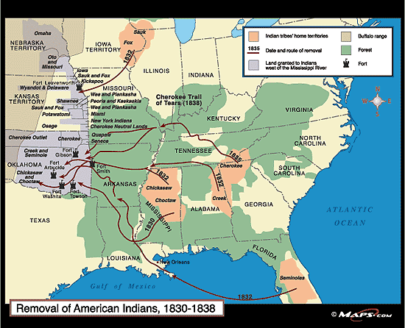

Slide 4
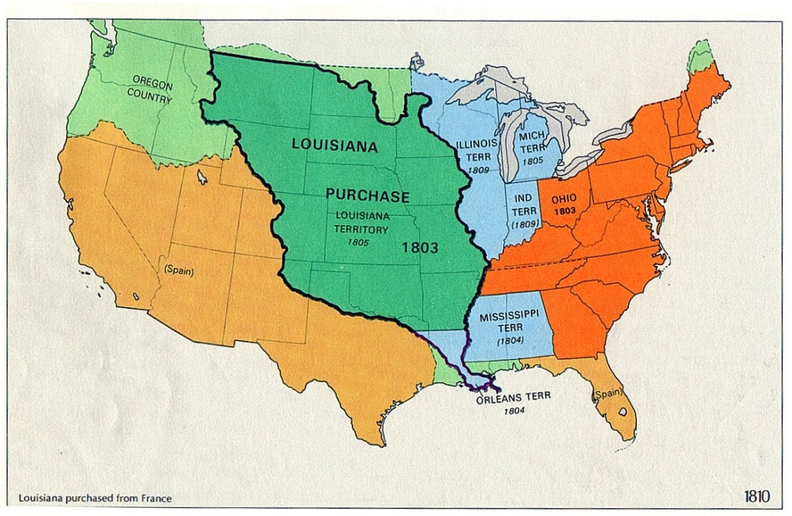
War of 1812
Louisiana Purchase 1803

Slide 5
Oregon Treaty of 1846
Texas
1846-1848 – the Mexican-American War
1853 – Gadsden Purchase
1867 – Alaska Purchase

